Slide 1
V6 People &Organization
Security and Access Control Concepts and Implementation for R2009x

Slide 2
Learning Objectives
At the end of this module, you should be able to:
Describe the concepts behind ENOVIA Security in the P&O Model
Describe security constraints
Describe the P&O data model
Name a few best practices in P&O implementation

Slide 3
Agenda
1
Objective
2
Customer Security Constraints
3
P&O - Concepts
4
Data Model - Security Relationship
5
Security Illustration
6
Deployment
6.1
P&O Deployment
6.2
Security Deployment
7
OOTB P&O and Security
8
Customization Best Practices

Slide 4
Agenda
1
Objective
2
Customer Security Constraints
3
P&O - Concepts
4
Data Model - Security Relationship
5
Security Illustration
6
Deployment
6.1
P&O Deployment
6.2
Security Deployment
7
OOTB P&O and Security
8
Customization Best Practices

Slide 5
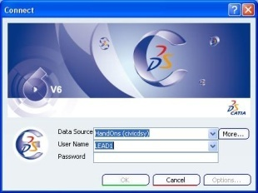
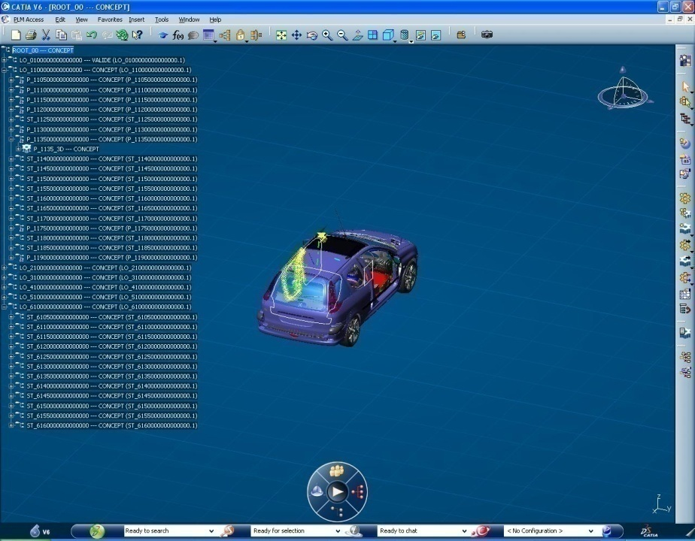


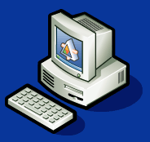
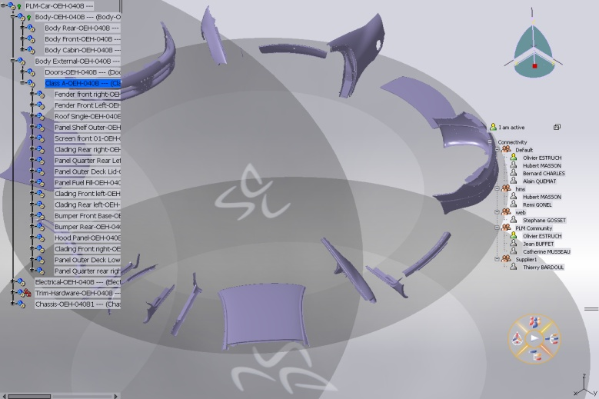
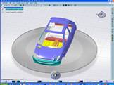
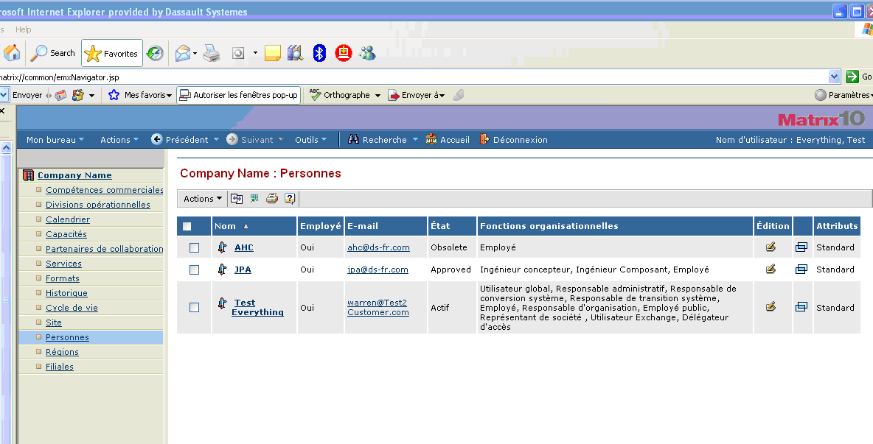

Objective
To provide a common solution compatible with the supported architecture, to allow a User to login inside DS Applications (interactive/batch mode) and to perform the ad-hoc PLM function and data access control.
To secure the end-to-end processes through all applications
VPM : Editor
VPM : PPR NAV
3D Live
EnoviaxBOM/Governance

Slide 6
Agenda
1
Objective
2
Customer Security Constraints
3
P&O - Concepts
4
Data Model - Security Relationship
5
Security Illustration
6
Deployment
6.1
P&O Deployment
6.2
Security Deployment
7
OOTB P&O and Security
8
Customization Best Practices

Slide 7
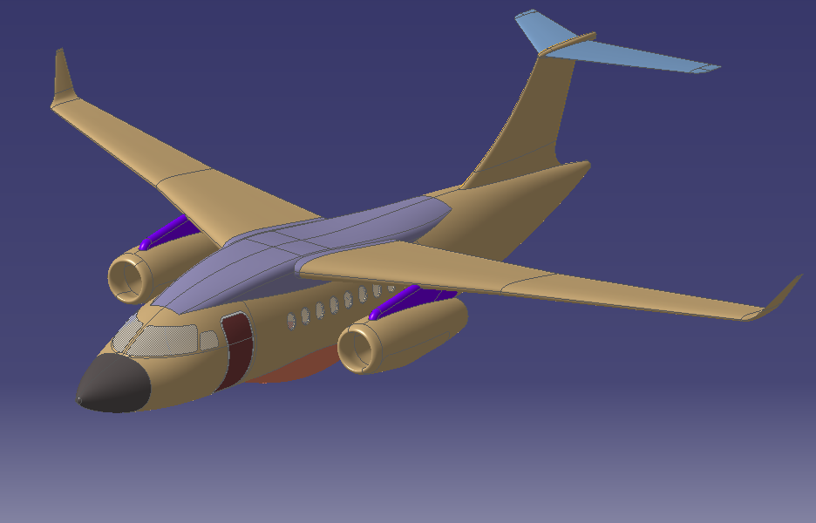
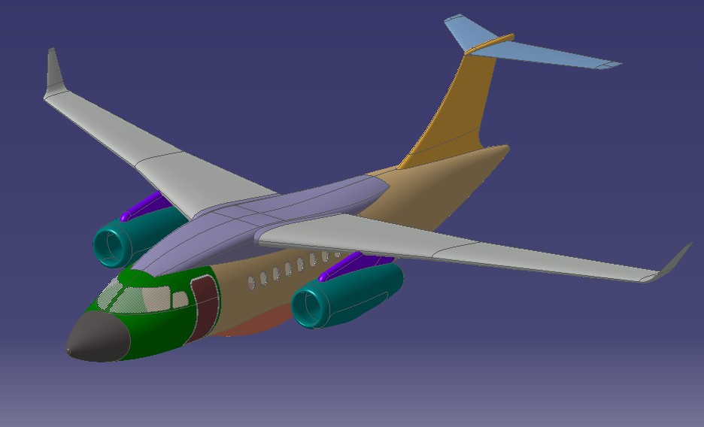
Customer Security Constraints
Ownership transfer
Security rules based on:
Data Ownership (user, org, project)
Supporting “Transfer Ownership”
Typical rule:
One user can see, modify or create
data belonging to his own organization.
User = Mr. Smith
Project= Aircraft
Org = OEM
Data Ownership
User = Mrs. Doe
Project= Airframe
Org = Supplier 01
User = Mr. Tailor
Project = Airframe
Org = Supplier 02
User = Mrs. Smith
Project = Aircraft
Org = OEM
User = Mr. Watson
Project = Propulsion
Org = Supplier 03
User = Mr. Holmes
Project = Cockpit
Org = OEM

Slide 8
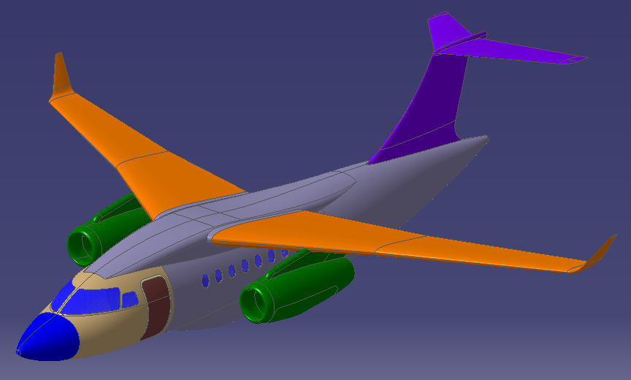
Customer Security Constraints
Security rules based on:
Work package
Typical rules:
For one user belonging to an organization, the visibility onto a data is driven by the package number of the data. Therefore one could define a matrix describing the list of work packages for which an organization may have visibility.
Work Package
WP 004
WP 001
WP 005
WP 003
WP 002
WP 006

Slide 9
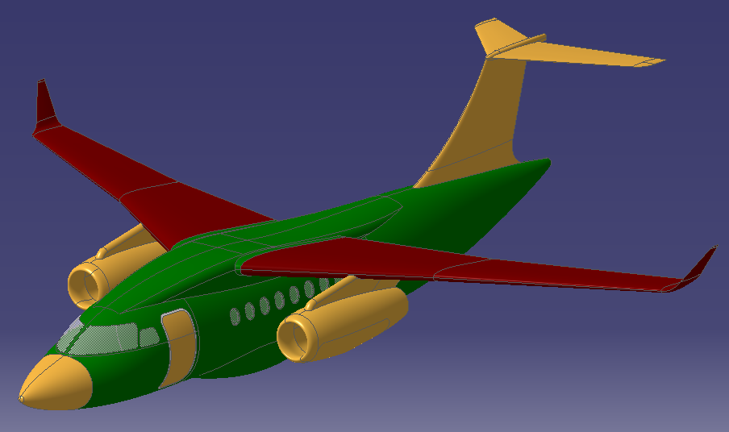
Customer Security Constraints
Security rules based on:
Data Maturity
Typical rules:
If a data has a « Private » maturity only the users of the organization (of the data) can have visibility on it.
If the maturity is « Shared » then all users has visibility on the data.
If the maturity is « Released » then no user can modify the data.
Maturity
Private
Released
Shared

Slide 10

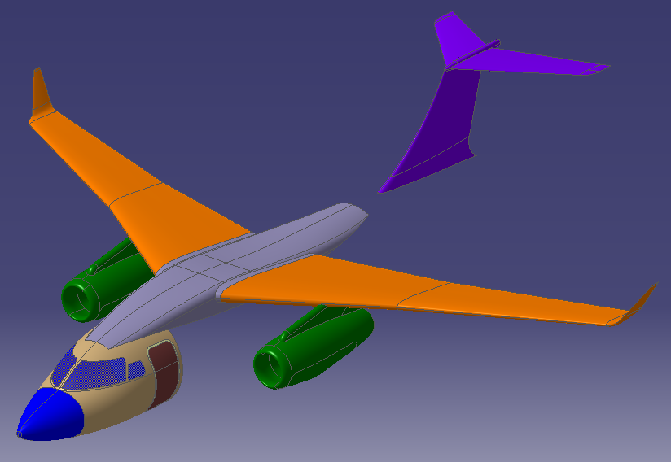
Customer Security Constraints
Security rules based on:
Specific Restricted Data Access
Typical rules:
The visibility of the data can be
forbidden to specific organizations.
Work Package
WP 003
Restricted Data Access
Restricted Data (hidden)
for the same Work Package
Not Restricted Data

Slide 11
Agenda
1
Objective
2
Customer Security Constraints
3
P&O - Concepts
4
Data Model - Security Relationship
5
Security Illustration
6
Deployment
6.1
P&O Deployment
6.2
Security Deployment
7
OOTB P&O and Security
8
Customization Best Practices

Slide 12


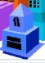
P&O - Concepts
Person
Represents a logical user
Has a user id and a password to login ENOVIA
The user id can be different from OS login
The user id can be administrated within LDAP
He belongs to an organization
He has a role
Organization
Defines a group of persons belonging to a same operational company entity
Can be a business unit, or a department of the company
Organizations can be connected in a hierarchical manner. This hierarchical structure can provide privileges by inheritance.
Mr.Doe
Mrs.Smith
Is a member of
OEM
Is a member of
Supplier 01
Supplier 02

Slide 13



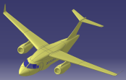
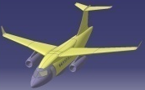
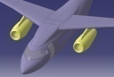
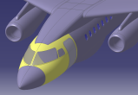
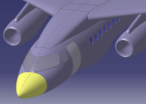
P&O - Concepts
Role
Defines the activity of a person
Roles can be connected in a hierarchical manner.
This hierarchical structure can provide privileges by inheritance.
Project
It represents the concept of a planned enterprise task
It drives the enterprise resources assignment
Projects can be connected in a hierarchical manner.
This hierarchical structure can provide privileges by inheritance.
Leader
Designer
Reviewer
Aircraft
Airframe
Propulsion
Cockpit
Avionics

Slide 14


P&O - Concepts
Security Context (1/2)
It is a working environment defined for one operational organization, one role and one project
It is assigned to users to enable them to fulfill their job requirements
One user can be assigned to several working contexts
Persons
Mr.Doe
Mrs.Smith
Security
Context
Is Assigned To
Is a member of
Is a member of
Is a member of
Roles
Leader
Organizations
OEM
Aircraft
Projects
Designer
Reviewer
Supplier 01
Supplier 02
Airframe
Propulsion
Cockpit
Avionic

Slide 15


P&O - Concepts
Security Context (2/2)
When creating data the active security context drives the ownership of the data
Persons
Mr.Doe
Mrs.Smith
Mr.Doe has three security contexts
Default security context
Is Assigned To
Is Assigned To
Active Security context
Data Ownership
User = Mrs. Doe
Project = Airframe
Org = Supplier 01
User = Mrs. Smith
Project = Aircraft
Org = OEM

Slide 16
Agenda
1
Objective
2
Customer Security Constraints
3
P&O - Concepts
4
Data Model - Security Relationship
5
Security Illustration
6
Deployment
6.1
P&O Deployment
6.2
Security Deployment
7
OOTB P&O and Security
8
Customization Best Practices

Slide 17
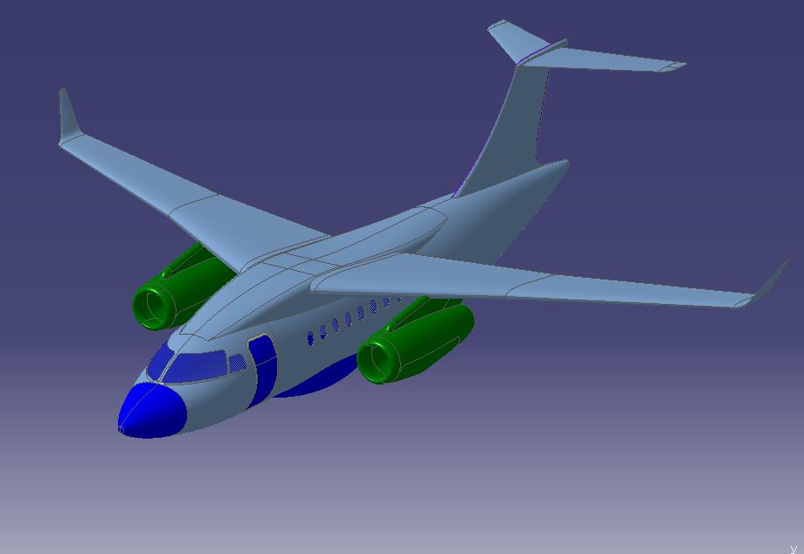
Data model – Security Relationship
Data Model (1/3)
RFLP is implemented via customization using different modelers
Some examples are:
Product modeler (e.g. physical structure)
Document modeler (e.g. documents and requirements management)
Simulation modeler (e.g. airflow simulation) …
Project = Propulsion
Modeler = Product
Customization = Equipment
Project = Airframe
Modeler = Simulation
Customization = CFD Analysis
Project = Airframe
Modeler = Product
Customization = Airframe
Project = Airframe
Modeler = Document
Customization = Tech. Description
Project = Avionics
Modeler = Document
Customization = Funct. Description
Project = Avionics
Modeler = Product
Customization = Systems

Slide 18
Data model – Security Relationship
Data Model (2/3)
Each modeler customization is stored in ENOVIA within objects called “type” and “relation”
VPM Central
xBOM / Governance Centrals
Port
Reference
Connection
Instance
Eng
Central
xxx Central
Core Modeling
Port
Ref
Rep
Connection
Ref Inst
Rep Inst
Part
EBOM
…
…
PLMPortDS
PLMProdDS
PLMRepDS
PLMConDS
PLMRefInstDS
PLMRepInstDS
PartDS
EBOMDS
…
…
Model Customization
Type custo
Relation custo

Slide 19
Data model – Security Relationship
Data Model (3/3)
The ENOVIA “types” and “relations” are respectively governed by “policies” and “rules”
“Policies” and “rules” provide grants for access control to person objects, organizations, etc…
VPM Central
xBOM / Governance Centrals
Port
Reference
Connection
Instance
Eng
Central
xxx Central
Core Modeling
Port
Ref
Rep
Connection
Ref Inst
Rep Inst
Part
EBOM
…
…
PLMPortDS
PLMProdDS
PLMRepDS
PLMConDS
PLMRefInstDS
PLMRepInstDS
PartDS
EBOMDS
…
…
Model Customization
Type custo
Relation custo
governs
governs
Common Security
Policy
Rule
gives access to
gives access to
Common
P&O
User
(Person, Organization, Role, …)

Slide 20
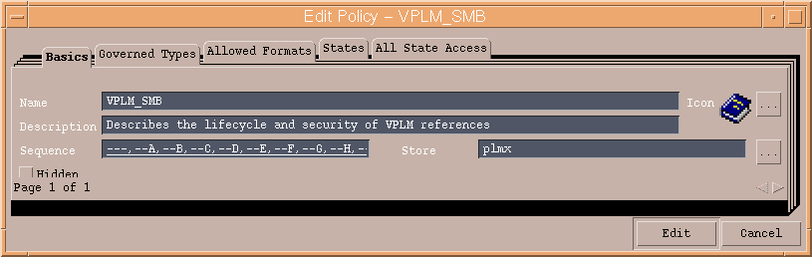
Policy Concepts
The policies define the lifecycle graph
States
Transitions
Check Triggers on promotion event
The policies define the security access rights
Globally (for all states) or specific for each states
Access rights are given to “user” object:
person, role, org, project, security context
Access rights can be modified by filters
A filter defines a restriction clause on an access grant
The policies define the version sequencing
PLM Type
Customization
1,n
Governs
1,n
Policy
Lifecycle
Access
Filters
0,n
Gives access to
0,n
User
Security
Context
Project
Role
Org
0,n
Person
0,n
Work assignment

Slide 21
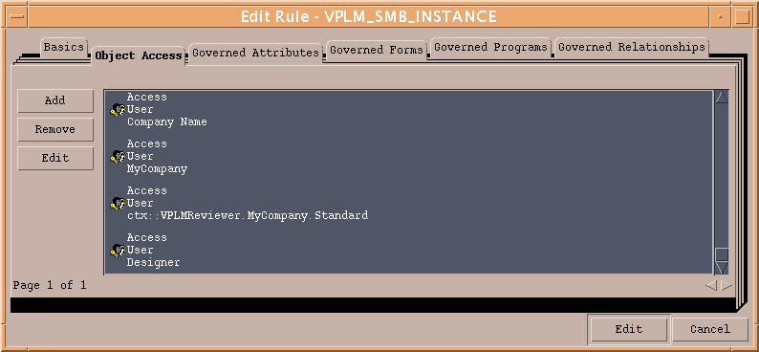
Rules Concepts
The rules define the security access rights
Access rights are given to “user” objects:
person, role, org, project, security context
Access rights can be modified by filters
A filter defines a restriction clause on an access grant
PLM Relation
Customization
1,n
Governs
1,n
Rule
Access
Filters
0,n
Gives access to
0,n
User
Security
Context
Project
Role
Org
0,n
Person
0,n
Work assignment

Slide 22
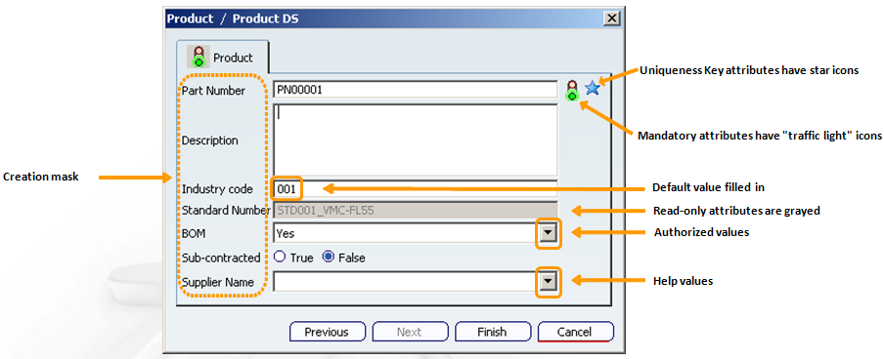
Mask Concepts
On PLM objects, the security mask governs
The attribute visibility on operations such as :
Create & Edit
Search, Result & Display
Whether the attribute is modifiable or not
Default value or range of values for an attribute
The security mask can be assigned to
Person, Organization, Role and Project
A combination of them (i.e. Security Context)
Note: In V6R2009x mask is deployed on
VPM Central only
PLM Object Attributes
1,n
Governs
1,n
Mask
Visibility
Editability
Valuation
0,n
Is assigned to
0,1
User
Security
Context
Project
Role
Org
0,n
Person
0,n
Work assignment

Slide 23
Commands Security Concepts
Access to commands in the User Interface
For xBOM/Governance interface
All functions can be secured
For VPM central user commands (V6R2009x)
Import/Export
Detach Distant Data From DataBase (SRM)
New Version Using Distant Data (SRM)
Synchronize with Collaboration Environment
Administration commands
More to come in future releases
For CAA user commands
i.e. customer defined function
Commands can be granted to:
Person, Organization, Role and Project
A combination of them (i.e. Security Context)
Command
Access
0,n
Gives access to
0,n
User
Security
Context
Project
Role
Org
0,n
Person
0,n
Work assignment

Slide 24
Agenda
1
Objective
2
Customer Security Constraints
3
P&O - Concepts
4
Data Model - Security Relationship
5
Security Illustration
6
Deployment
6.1
P&O Deployment
6.2
Security Deployment
7
OOTB P&O and Security
8
Customization Best Practices

Slide 25
Security Illustration #1: Access Scope
Part
Access: Read
Filter: MyOrgData
Access: Read,Modify
Filter: MyData
Part 1
Dassault
Person
Product 1
Systems
Role
Part 2
Project
Structure
Organization
Product 2
Wings
Security Context
Part 3
IsParentOf
Fuselage
Part 4
Policy
Reviewer
Access Privilege
Part 5
Access Inheritance Scope
Reviewer.Structure.Airframe
Part 6
GrantsAccessTo
Airframe
AppliesTo
John
Part 7
PLM Data
Product 3
IsOwnedBy
Designer
Designer.Structure.Airframe
Accessible PLM Data
Associated To
John gets the “read” access item assigned to his organization “Structure”
John has “read” access to all Parts belonging to the organization “Structure”
John doesn’t have “read” access to Parts belonging to the other organizations because of the filter “MyOrgData”
John doesn’t have “read” & “modify” access to his own Parts because he doesn’t inherit the corresponding access item
John doesn’t have any access to Products because he doesn’t inherit any access item on Products

Slide 26
Security Illustration #2: Access Scope
Part
Access: Read
Filter: MyOrgDescendantData
Access: Read,Modify
Filter: MyData
Part 1
Dassault
Person
Product 1
Systems
Role
Part 2
Project
Structure
Organization
Product 2
Wings
Security Context
Part 3
IsParentOf
Fuselage
Part 4
Policy
Reviewer
Access Privilege
Part 5
Access Inheritance Scope
Reviewer.Structure.Airframe
Part 6
GrantsAccessTo
Airframe
AppliesTo
John
Part 7
PLM Data
Product 3
IsOwnedBy
Designer
Designer.Structure.Airframe
Accessible PLM Data
Associated To
John gets the “read” access item assigned to his organization “Structure”
John has “read” access to all Parts belonging to the organization “Structure” and to its child organizations
John doesn’t have “read” access to Parts belonging to the other organizations because of the filter “MyOrgDescendantData”
John doesn’t have “read” & “modify” access to his own Parts because he doesn’t inherit the corresponding access item
John doesn’t have any access to Products because he doesn’t inherit any access item on Products

Slide 27
Security Illustration #3: Access Scope
Part
Access: Read
Filter: MyOrgDescendantData
Access: Read,Modify
Filter: MyData
Part 1
Dassault
Person
Product 1
Systems
Role
Part 2
Project
Structure
Organization
Product 2
Wings
Security Context
Part 3
IsParentOf
Fuselage
Part 4
Policy
Reviewer
Access Privilege
Part 5
Access Inheritance Scope
Reviewer.Structure.Airframe
Part 6
GrantsAccessTo
Airframe
AppliesTo
John
Part 7
PLM Data
Product 3
IsOwnedBy
Designer
Designer.Structure.Airframe
Accessible PLM Data
Associated To
John gets the “read” access item assigned to the organization “Dassault”
John has “read” access to all Parts belonging to the organization “Structure” and to its child organizations
John doesn’t have “read” access to Parts belonging to the other organizations because of the filter “MyOrgDescendantData”
John doesn’t have “read” & “modify” access to his own Parts because he doesn’t inherit the corresponding access item
John doesn’t have any access to Products because he doesn’t inherit any access item on Products

Slide 28
Security Illustration #4: Multi-Context
Part
Access: Read
Filter: MyOrgDescendantData
Access: Read,Modify
Filter: MyData
Part 1
Dassault
Person
Product 1
Systems
Role
Part 2
Project
Structure
Organization
Product 2
Wings
Security Context
Part 3
IsParentOf
Fuselage
Part 4
Policy
Reviewer
Access Privilege
Part 5
Access Inheritance Scope
Reviewer.Structure.Airframe
Part 6
GrantsAccessTo
Airframe
AppliesTo
John
Part 7
PLM Data
Product 3
IsOwnedBy
Designer
Designer.Structure.Airframe
Accessible PLM Data
Associated To
John gets the “read” access item assigned to the organization “Dassault”
John has “read” access to all Parts belonging to the organization “Structure” and to its child organizations
John has “read” & “modify” accesses to his own Parts
John doesn’t have Read access to Parts belonging to organizations “Dassault” or “Systems” because they are not children of the organization “Structure”
John doesn’t have any access to Products because he doesn’t inherit any access item on Products

Slide 29
Security Illustration #5: Multi-Context
Part
Access: Read
Filter: MyOrgDescendantData
Access: Read,Modify
Filter: MyData
Part 1
Dassault
Person
Product 1
Systems
Role
Part 2
Project
Structure
Organization
Product 2
Wings
Security Context
Part 3
IsParentOf
Fuselage
Part 4
Policy
Reviewer
Access Privilege
Part 5
Access Inheritance Scope
Reviewer.Structure.Airframe
Part 6
GrantsAccessTo
Airframe
AppliesTo
John
Part 7
Policy_Product
PLM Data
Access: Read
Filter: MyOrgDescendantData
Product 3
IsOwnedBy
Designer
Designer.Structure.Airframe
Accessible PLM Data
Associated To
John gets the “read” access item assigned to the organization “Dassault”
John has “read” access to all Parts belonging to the organization “Structure” and to its child organizations
John has “read” & “modify” accesses to his own Parts
John has Read access to all Products belonging to children of context organization VPLM Server
John doesn’t have Read access to Products belonging to organizations PLM Infra or PLM Core because they are not children of context organization VPLM Server

Slide 30
Agenda
1
Objective
2
Customer Security Constraints
3
P&O - Concepts
4
Data Model - Security Relationship
5
Security Illustration
6
Deployment
6.1
P&O Deployment
6.2
Security Deployment
7
OOTB P&O and Security
8
Customization Best Practices

Slide 31
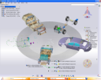
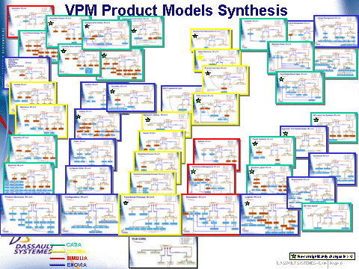
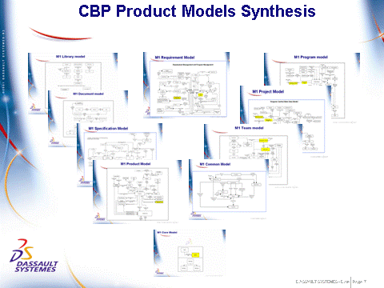
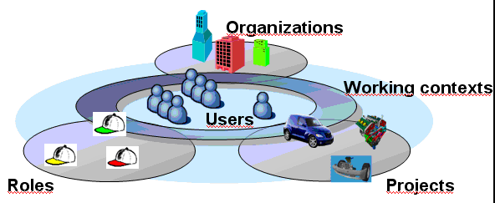
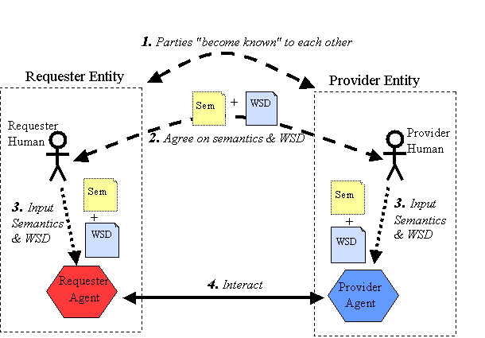
Deployment
VPM Modeling
xBOM/Governance Modeling
V6 Customization Blocks
VPLM Modeling
CBP Modeling
Common P&O
Common Security
PLM Web Services
Program/Script
DS-Metadata
DS-Schema
DS-P&O
DS-Policy/Rules
3DXml-WSIL/XSD
DS-Scripts
IDE / DMC
Business
Web UI / Import
Business / MQL
IDE
Business / MQL
Custo-Metadata
Custo type
Custo-P&O
Custo-Policy/Rules
Custo WS
Custo-Script
Policies
Access Modify
Filter MyData
CTX:

Slide 32
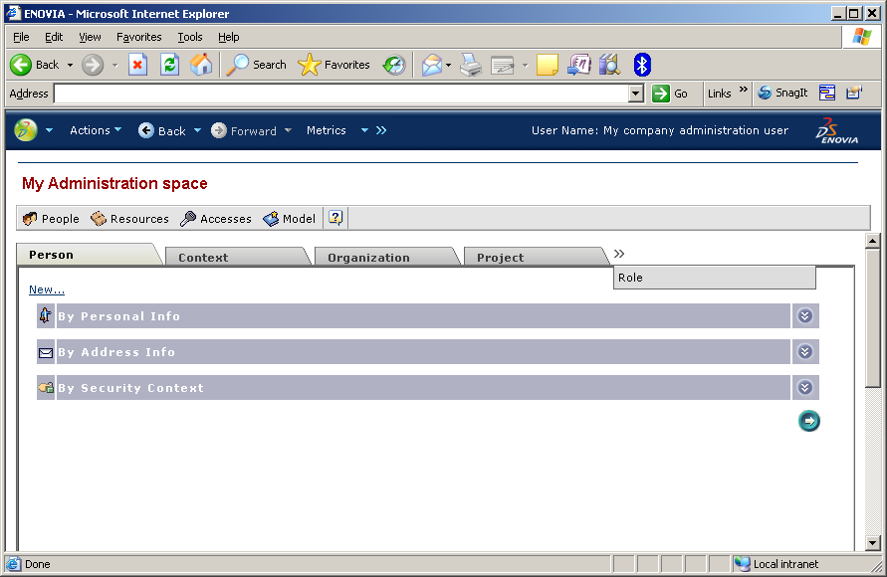
P&O - Deployment
GUI Tool (1/3)
Admin Web Console
It is the recommended P&O administration tool

Slide 33
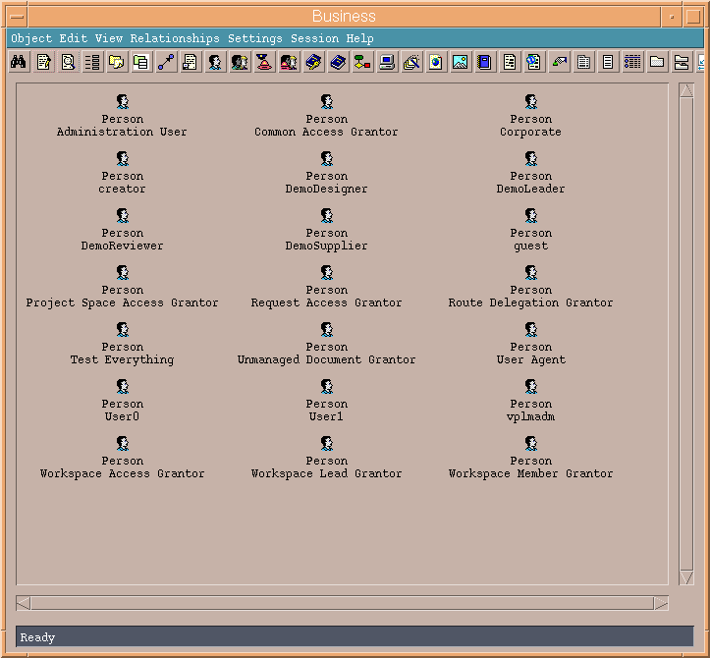
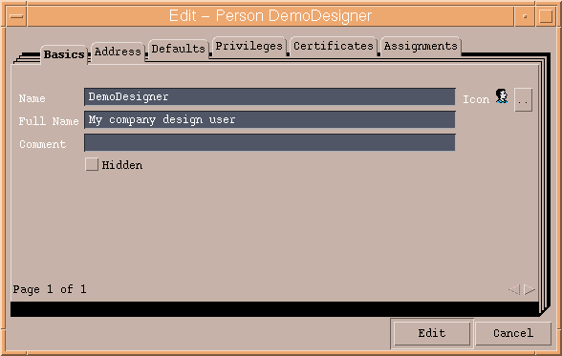
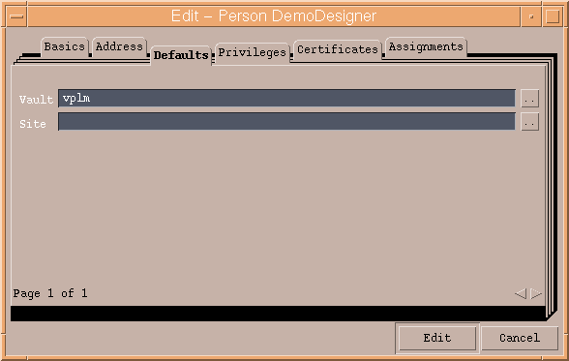
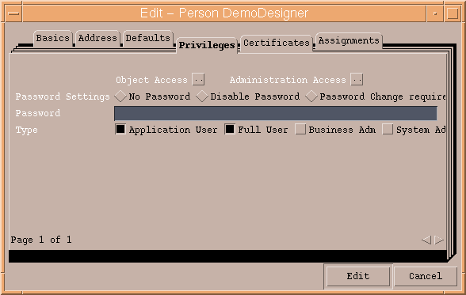
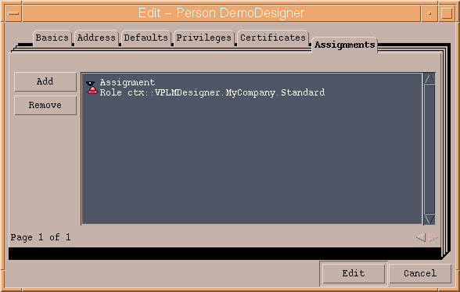
P&O - Deployment
GUI Tool (2/3)
Business – “Person”
Double click on the person to view and edit its properties
Default user privileges and password properties…
Modify the list of assigned contexts
Basic properties: name, full name…
Default store and site

Slide 34
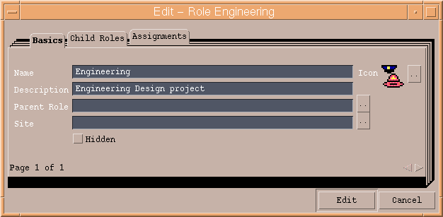
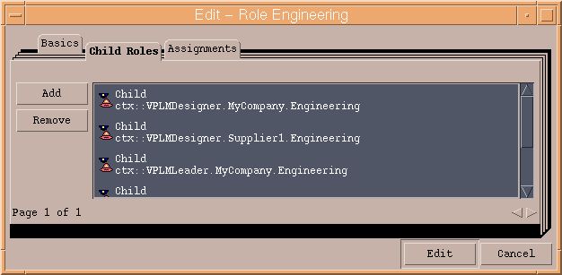
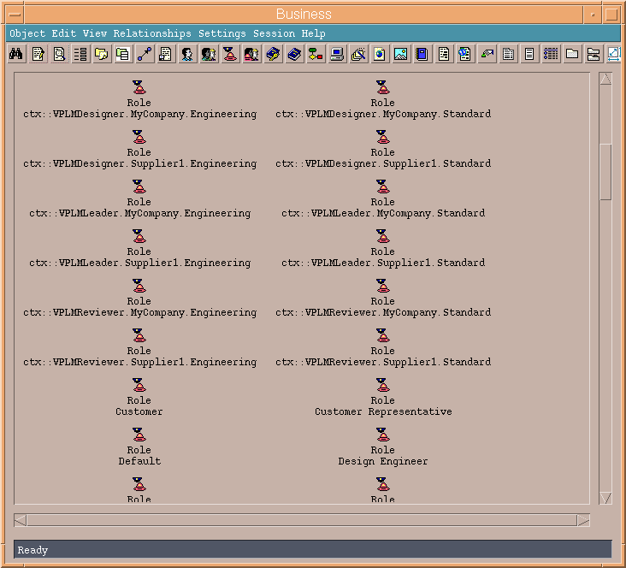
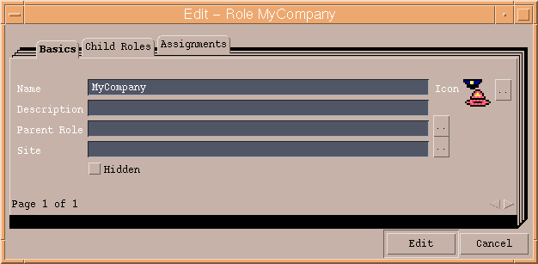
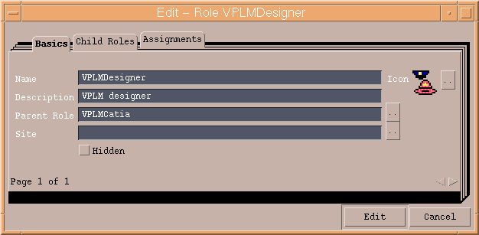
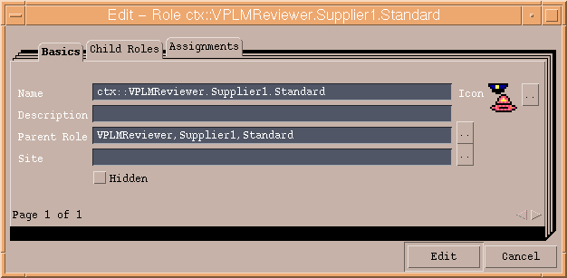
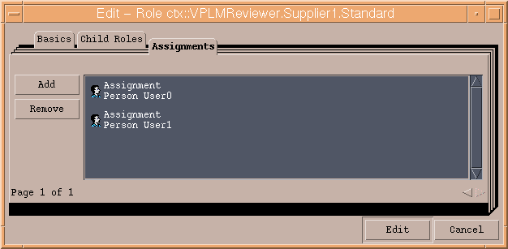
P&O - Deployment
GUI Tool (3/3)
Business – “Org, Project, …”
Project Engineering
Contexts using the Engineering Project
Organization MyCompany
Role VPLMDesigner
Double click on the Project, Organization, Role… to view and edit its properties
Context: VPLMReviewer.Supplier1.Standard
Persons assigned to the context

Slide 35
P&O - Deployment
Batch Tools (1/4)
VPLMPosImport:
Batch tool to create your P&O data
Uses a file with a specific proprietary import syntax
defining the P&O objects that are to be created
VPLMPosExport:
Batch tool to extract your P&O data from the V6 Repository
The result is a file using the same import syntax as that
managed by VPLMPosImport.
Tools available only in VPM Central

Slide 36
P&O - Deployment
Batch Tools (2/4)
Input / output file syntax
Keywork | Usage
*PRJ | *PRJ <id>;[<parent id>];[<description>] Example:*PRJ MyNewPrj;$;This is my new project
*COMPANY | *COMPANY <id>;[<parent id>];[<description>] Example: *COMPANY MyCompany
*BUSINESSUNIT | *BUSINESSUNIT <id>;<parent id>;[<description>] Example: *BUSINESSUNIT BU1;MyCompany;My_Business_Unit_1
*ROLE | *ROLE <id>;[<parent id>];[<description>] Example: *ROLE MyDesigner;VPLMCatia;My_Designer_role
*CONTEXT | *CONTEXT <role id>;<organization id>;<project id>;[<description>] Example: *CONTEXT MyDesigner;BU1;MyNewPrj;Designer_context
*PERSON | To add your People: *PERSON <id>;<company id> To Assign your people to their dedicated contexts +CONTEXT <context id> Example: To assign the Designer context of BU1 on project MyNewPrj: *PERSON MyUser;MyCompany +CONTEXT MyDesigner.BU1.MyNewPrj

Slide 37
P&O - Deployment
Batch Tools (3/4)
Launching VPLMPosImport
On UNIX:
INSTALL_PATH/Studio/Apps/VPMMultiDiscipline/V6R2009x/scripts/VPLMPosImport.sh
On WINDOWS:
INSTALL_PATH\Studio\Apps\VPMMultiDiscipline\V6R2009x\bin\winnt\VPLMPosImport.bat
Where MANDATORY ARGUMENTS are:
-user userid P&O user identifier to be used in order to connect to the Matrix VPLM repository
-password pwd User password to be used in order to connect to the Matrix VPLM repository
-server urlURL of the Matrix VPLM server, e.g. http://localhost:8080/ematrix
-file importfile Full path & name of the input ascii import file
And OPTIONAL ARGUMENTS are:
-context contextid P&O context identifier to be used to connect to the Matrix VPLM repository
(the default is ctx::VPLMAdmin.MyCompany.Default)
-no-abort-on-error Have the import engine resume execution upon error (the default behaviour is to abort the execution as soon as an error is encountered)
-report reportfile Full path & name of the optional output report file; if specified, the execution status of all import commands are written to the report file
-h Display help
-syntax Display help on import syntax; requires –h

Slide 38
P&O - Deployment
Batch Tools (4/4)
Launching VPLMPosExport
On UNIX:
INSTALL_PATH/Studio/Apps/VPMMultiDiscipline/V6R2009x/scripts/VPLMPosExport.sh
On WINDOWS:
INSTALL_PATH\Studio\Apps\VPMMultiDiscipline\V6R2009x\bin\winnt\VPLMPosExport.bat
Where MANDATORY ARGUMENTS are:
-user userid P&O user identifier to be used in order to connect to the Matrix VPLM repository
-password pwd User password to be used in order to connect to the Matrix VPLM repository
-server urlURL of the Matrix VPLM server, e.g. http://localhost:8080/ematrix
-object type:id Have the export engine export a particular P&O object, below is the list of supported object types and the corresponding P&O Security objects:
context P&O context (e.g. VPMADMIN.ADMIN.DEFAULT)
organization P&O organization
person P&O person
project P&O project
role P&O role
(Rmk: parameter “-object” can be specified several times in a single command-line so as to export several objects)
-file exportfile Full path & name of the output import file; the specified file path must be writable by the batch program; the file is created if necessary, and overwritten if it already exists.
And OPTIONAL ARGUMENTS are:
-context ctx_id P&O context identifier to be used to connect to the Matrix VPLM repository
(the default is ctx::VPLMAdmin.Admin.Default)
-h display help

Slide 39
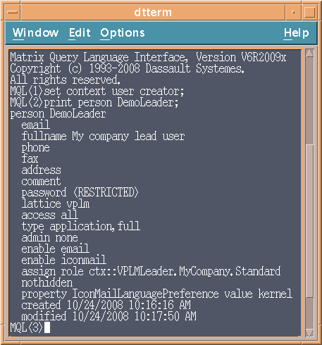
P&O - Deployment
Command Line Tool
Matrix Query Language (MQL)
Note: Need to know the data model
For instance to get the list of available roles, persons, policy… :
MQL<1> list role;
MQL<2> list person;
MQL<3> list policy;
…
To create a new role:
MQL<1> add role ROLE_NAME [OPTIONS];
To create a new user and modify its password:
MQL<1> add person PERSON_NAME [OPTIONS];
MQL<2> modify person PERSON_NAME password PWD_VALUE;
To get help in MQL:
MQL<1> help role;
MQL<2> help person;
…

Slide 40
Agenda
1
Objective
2
Customer Security Constraints
3
P&O - Concepts
4
Data Model - Security Relationship
5
Security Illustration
6
Deployment
6.1
P&O Deployment
6.2
Security Deployment
7
OOTB P&O and Security
8
Customization Best Practices

Slide 41
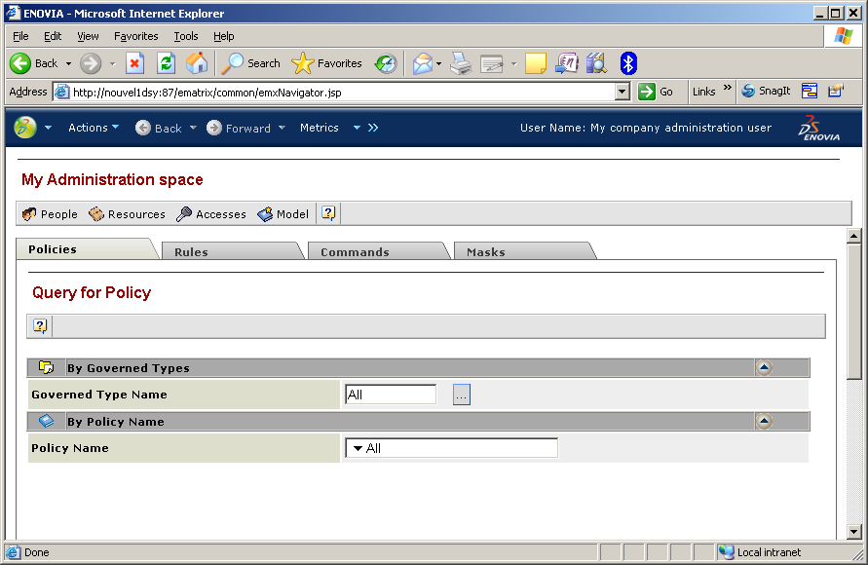
P&O - Deployment
GUI Tool (1/3)
Admin Web Console
It is the recommended security administration tool

Slide 42
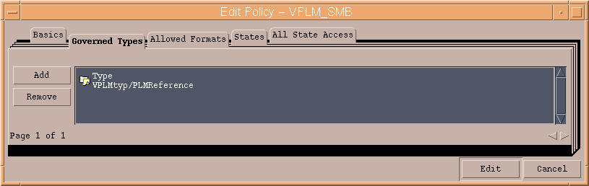
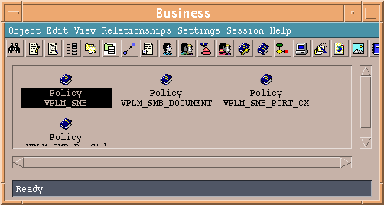
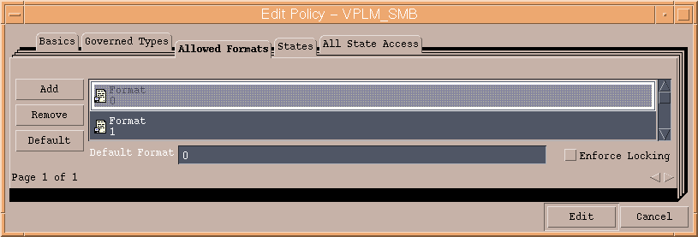
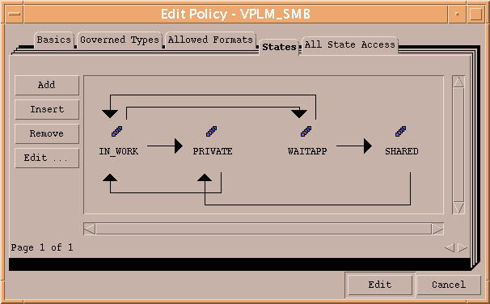
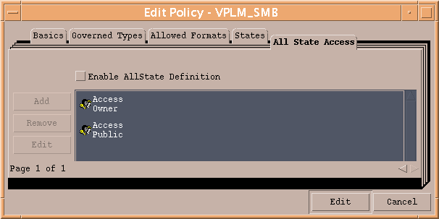
Security - Deployment
GUI Tool (2/3)
Business Modeler – Policy properties
2. Revisions labels and default store
3. Governed Types
1. Double click on the Policy to view and edit its properties
4. Allowed formats
5. Lifecycle Graph
6. Lifecycle Graph

Slide 43
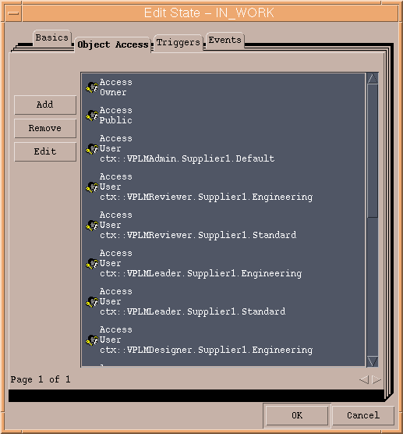
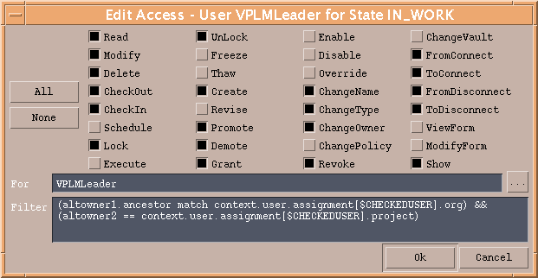
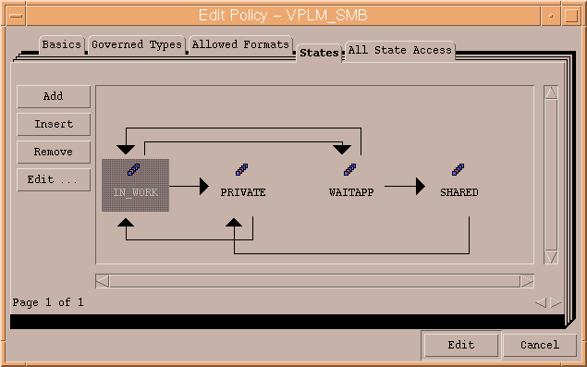
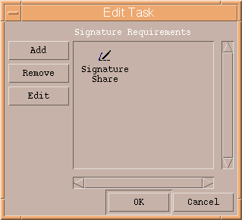


Security - Deployment
GUI Tool (3/3)
Business Modeler – Lifecycle properties
…to get the list of grants
…to get the accesses and the filter
Edit one Lifecycle State…
Edit one grant…
…to modify signature definition
…to get the list of signatures
Edit one Transition…
Edit one signature…

Slide 44

Security - Deployment
Command Line Tool
Matrix Query Language (MQL)
Note: Need to know the data model
To view a policy in MQL:
MQL<1> print policy POLICY_NAME;
To modify a policy in MQL:
MQL<1> modify policy POLICY_NAME [OPTIONS];

Slide 45
Agenda
1
Objective
2
Customer Security Constraints
3
P&O - Concepts
4
Data Model - Security Relationship
5
Security Illustration
6
Deployment
6.1
P&O Deployment
6.2
Security Deployment
7
OOTB P&O and Security
8
Customization Best Practices

Slide 46
Default P&O / Security – OOTB Default Configuration
Key drivers / requirements
Ready to use after installation
Simple model for small- to medium- sized businesses
Solution that is easy to install and to use
Simplified P&O / Security administration
Transparent to end-user
Solution
P&O startup data in ENOVIA Server
Pre-installed P&O data
Pre-installed Function and Data Access Control
P&O - Security startup data definition
Default P&O to address 6 CATIA user roles and use cases
Default privileges defined by CATIA user roles
Benefits
Predefined security roles to address basic needs out of the box for SMB market
More complex rules and be created via GUI or command-line tools for enterprise customers

Slide 47



Default P&O on V6R2009x
Assumptions:
Two projects for data classification
Two organizations
Three roles
Access Rights based on
Data ownership
Project ownership
Organization ownership
Default grants on OOTB
customizations:
Product, Simulation, …
Vision
Concept
Experience
Definition
People and Roles
Access Control
Administrator
Is granted to all functions and data
Standard Project
VPLMDesigner
Is granted on current Project and my data
VPLMLeader
Is granted on current Project and my Project data
VPLMReviewer
Is granted on current Project and shared Project data
Engineering Project
VPLMDesigner
Is granted on current Project and my data
VPLMLeader
Is granted on current Project and my Project data
VPLMReviewer
Is granted on current Project and shared Project data

Slide 48
PLM policy on V6R2009x – Default Lifecycle
Leader
Designer
Reviewer
MyProject = every data from current project
MyData = data owned by me
MyProject and MyData = data owned by me in current project only
Leader
Designer
Reviewer
Not deletable
Not versionable
Reject
Name of transition in
Business Modeler LCG
IN_WORK
Share
WAIT_APP
MyProject
Reject
KeepPrivate
Share
MyProject
Leader
Designer
Reviewer
Not modifiable
Leader
Designer
Reviewer
Not deletable
PRIVATE
SHARED
Downgrade
Maturity status of the PLM object
Current Project
MyProject
PLM Object is:
Roles
Any Project
MyProject and MyData
Not deletable
Team Leader
Not versionable
Designer
Not modifiable
Reviewer
Notes:
PRIVATE status:
Reviewer will never access any PRIVATE data.
Designer will only access his own data in the current project and will have all rights on them
Leader will access every PRIVATE data from current project and will have all rights on them
Policy: VPLM_SMB
Temp query bus VPLMtyp/PLMProductDS * * select name altowner1 altowner2
altowner1 = Organization
Altowner2 = Project
altowner1[<Organization>]

Slide 49
Agenda
1
Objective
2
Customer Security Constraints
3
P&O - Concepts
4
Data Model - Security Relationship
5
Security Illustration
6
Deployment
6.1
P&O Deployment
6.2
Security Deployment
7
OOTB P&O and Security
8
Customization Best Practices

Slide 50
Customization Best Practices
Goal
Preserve integrity of V6 data and V6 commands
How
Customized policies:
Copy the existing default policies to extend access control definitions and to define new lifecycle graphs for new customized modelers
Do not modify existing default policies
Specific to VPM central: associate customized modeler types with the customized VPM policies in the “policy chooser” file
Rule:
Copy the existing default rules to extend access control definitions
Specific to VPM central: do not copy the default VPM rule but extend the access control definitions of this rule
Recommendations for VPM central (1/3)
Carefully follow documented customization patterns for VPM policies (for example, to avoid data modification during promotion event)
Care must be taken during the definition of the customer P&O and Security model in order to avoid very large filter descriptions leading to massive data modification each time the P&O is changed or updated.
Get Dassault Systèmes (or IBM) support / approval if customer business rules exceed the scope of default policies / rule customization

Slide 51




Customization Best Practices
Recommendations for VPM central (2/3)
Care must be taken during security customization of VPM Instances, Ports and Connections: the security of these objects is linked to the lifecycle of the aggregating reference objects.
Stream
Skate type
Connection type
Rep1 type
Interface Left W
From
Relationship
To
Wheel ref type
CNX
Rep2 type
Port type
PartDS
Policy A
on PLMReference
Policy B
on PLMPort
Rules
on PLMInstance
Policy C
on Part
Access Read/show
Filter MyData
Designer
Read/Show access
Designer
Access Read/show
Filter MyData
Designer
Access Read/show
Filter MyData
Designer + Reviewer

Slide 52
Customization Best Practices
Recommendations for VPM central (3/3)
VPM Commands Integrity
 | V6 Operations/Commands (VPM/CATIA V6 view) | Access rights usage (Policy & Rule)
 | Query (Search) | Read, Show
 | Open (CV6 command) | Read, Show, CheckOut (to edit and modify representations)
 | Explore (CV6 command) | Read, Show, CheckOut (for navrep load)
 | Create | Create, Read, Show, Modify, ChangeOwner
 | Edit (Properties) (to save changes) | Modify (to save attribute changes), Read, Show, ChangeName
 | Save | Modify, Read, Show, CheckIn (to save Representation)
 | Delete | Delete
 | Add, Insert child (CV6 command) | FromConnect, ToConnect
 | Remove child (CV6 command) | FromDisconnect, ToDisconnect
 | Replace by existing | FromConnect, ToConnect, FromDisconnect, ToDisconnect
 | Cloning (CV6 command) | Create, Read, Show, Modify
 | Navrep Index Builder | Create, Read, Show, Modify, CheckOut, CheckIn, FromConnect
 | New Version | For the initial state: Read, Show, Revise, CheckOut For the target state: Read, Show, Create, Modify, CheckIn
 | Change Status | Promote
 | TransfertOwnership | ChangeOwner
 | Lock | Lock
 | Unlock | UnLock
Search commands
Save commands
Short transactions

